Slide 1
Effects of cannabis use
Examining the Structural changes in the brain of cannabis users over a 3 year period

Slide 2
Data set
Data is on 42 subjects with 2 MRIs per subject taken 3 years apart
22 of the subjects were control non-users
20 were cannabis users with varying usage rates
The subjects also filled out a form to have a CUDIT (Cannabis Use) score for each subject at the time of the first and second scan

Slide 3
Research Question and hypothesis
What regions of the brain, if any, are most affected by cannabis use?
Other studies have found that:
“...regular cannabis use is “associated with gray matter volume reduction in the medial temporal cortex, temporal pole, parahippocampal gyrus...” (Battistella et al., 2014).
“In this study, we found that chronic exposure to marijuana reduces OFC (Orbital Frontal Cortex) gray matter volume...” (Gilman et al., 2014)

Slide 4
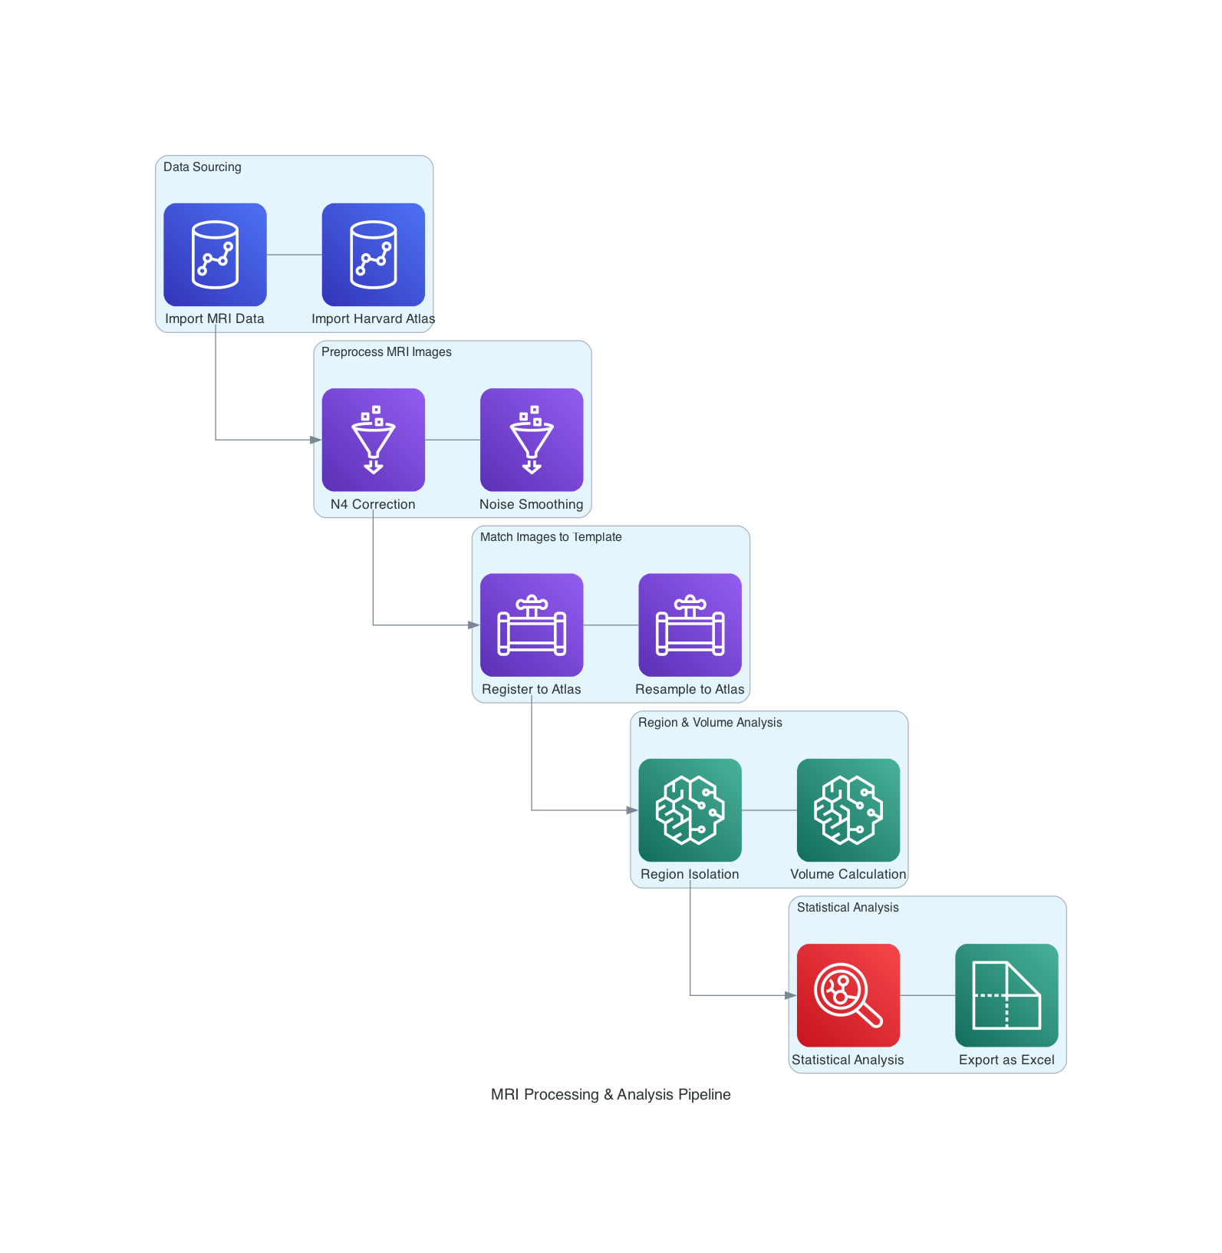
Project Structure
Data Sourcing
MRI Preprocessing
Matching MRI to template
Region & Volume Analysis
Statistical Analysis

Slide 5
Analysis tools
MRI Libraries
ANTS – Advanced Normalization Tools used to register the images
NILEARN – Library for analysis of MRI data
General Libraries
PANDAS – Data Handling
SKLEARN – Machine Learning
Matplotlib/Seaborn – Data visualizations

Slide 6
Data sourcing
The MRI data is from the Open Neuro Database
The Harvard Atlas is a standardized map of the brain sectioned off by region
Can be overlayed on any given MRI image

Slide 7
preprocessing
A noise smoothing algorithm is applied to make it easier to see real trends in the image data.
A special bias correction for MRI data to reduce noise caused by variations in the magnetic field

Slide 8
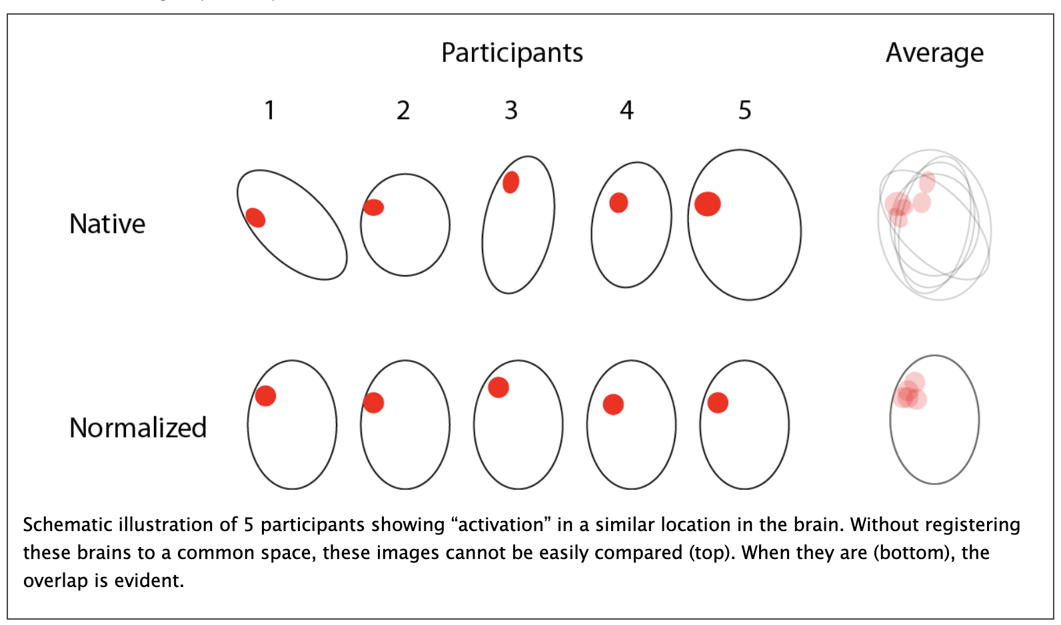
Registering images

Slide 9
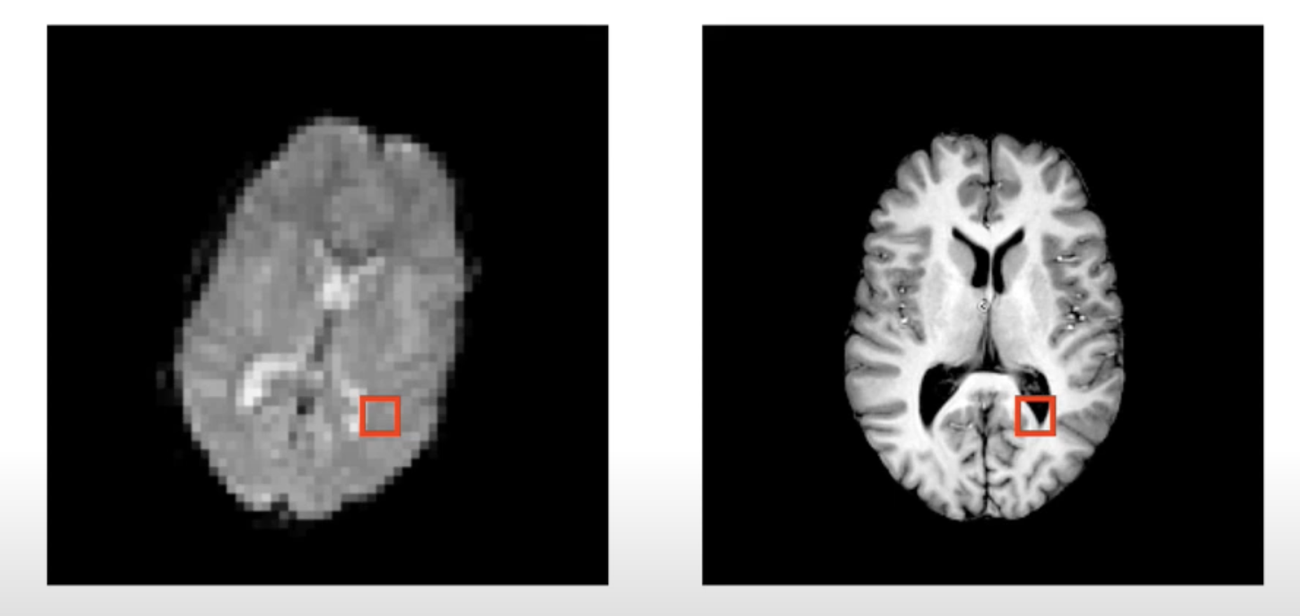
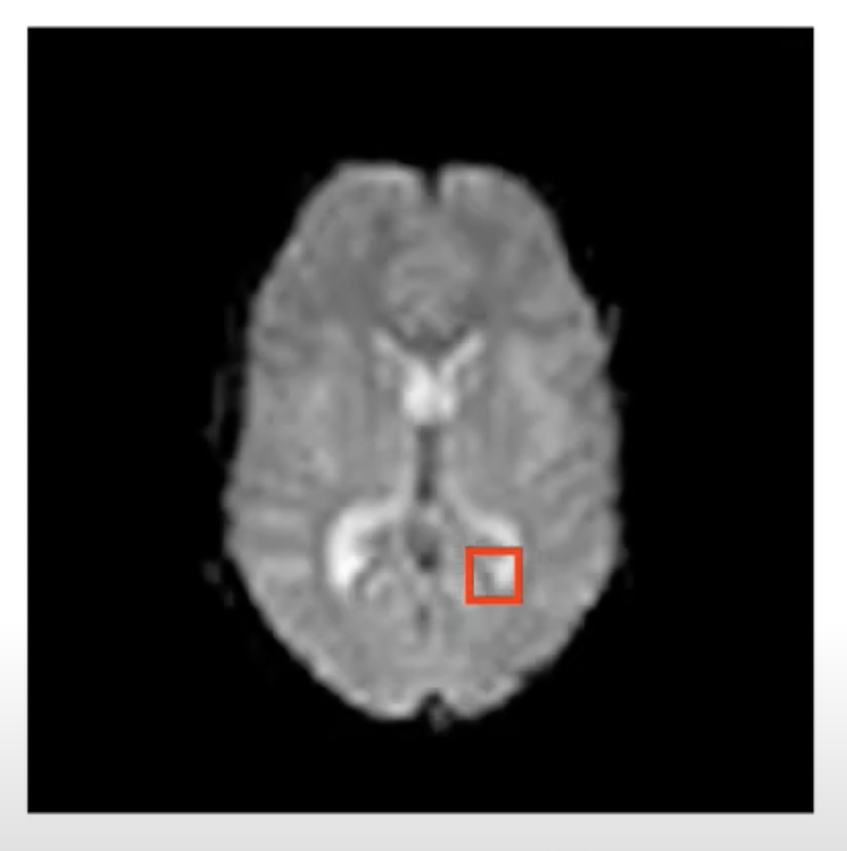
Registering images

Slide 10
Processing the images
The next step is to loop over the registered images and isolate each region per subject
The next step is calculating the volume for each image per subject of the region
MRI data is stored in “Voxels” which are volume-based pixels. To find the total volume you add up the values for the voxels in the given region

Slide 11
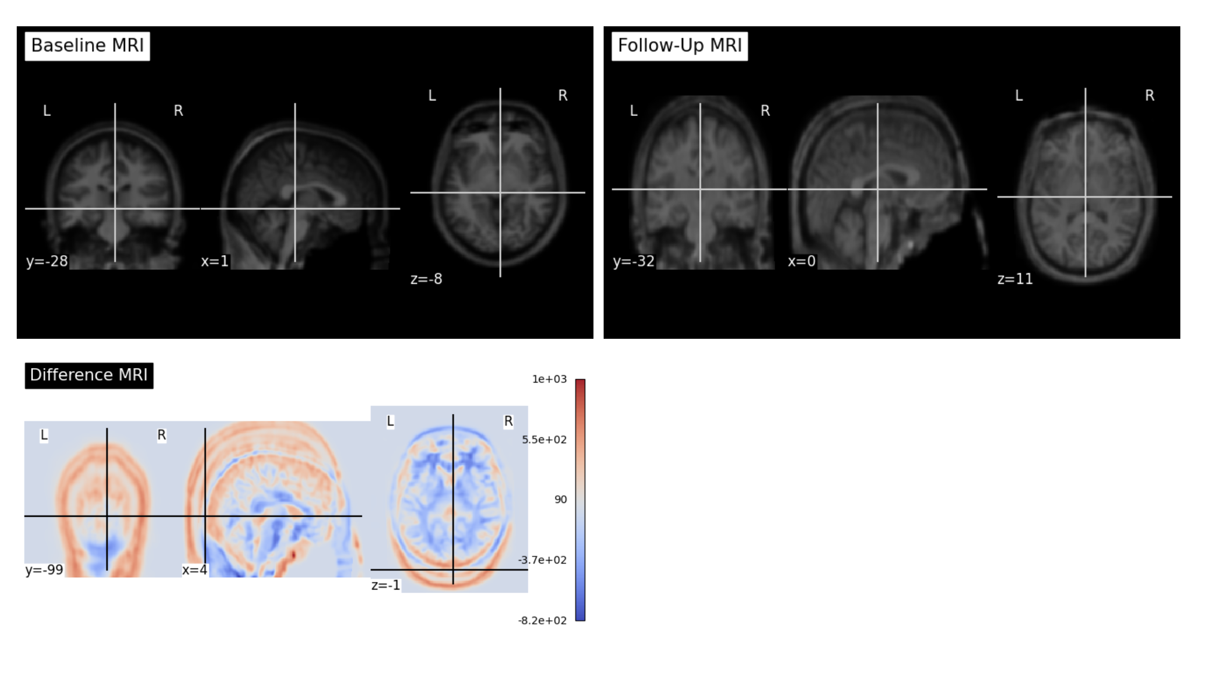
Difference Map

Slide 12
Statistical analysis
We now have a data table of every region’s volume change for every subject.
Now we will apply a linear regression model to see which region correlates with the subjects CUDIT score.
We will also check the P value of the correlation to ensure there is a significant relationship between the two values.

Slide 13
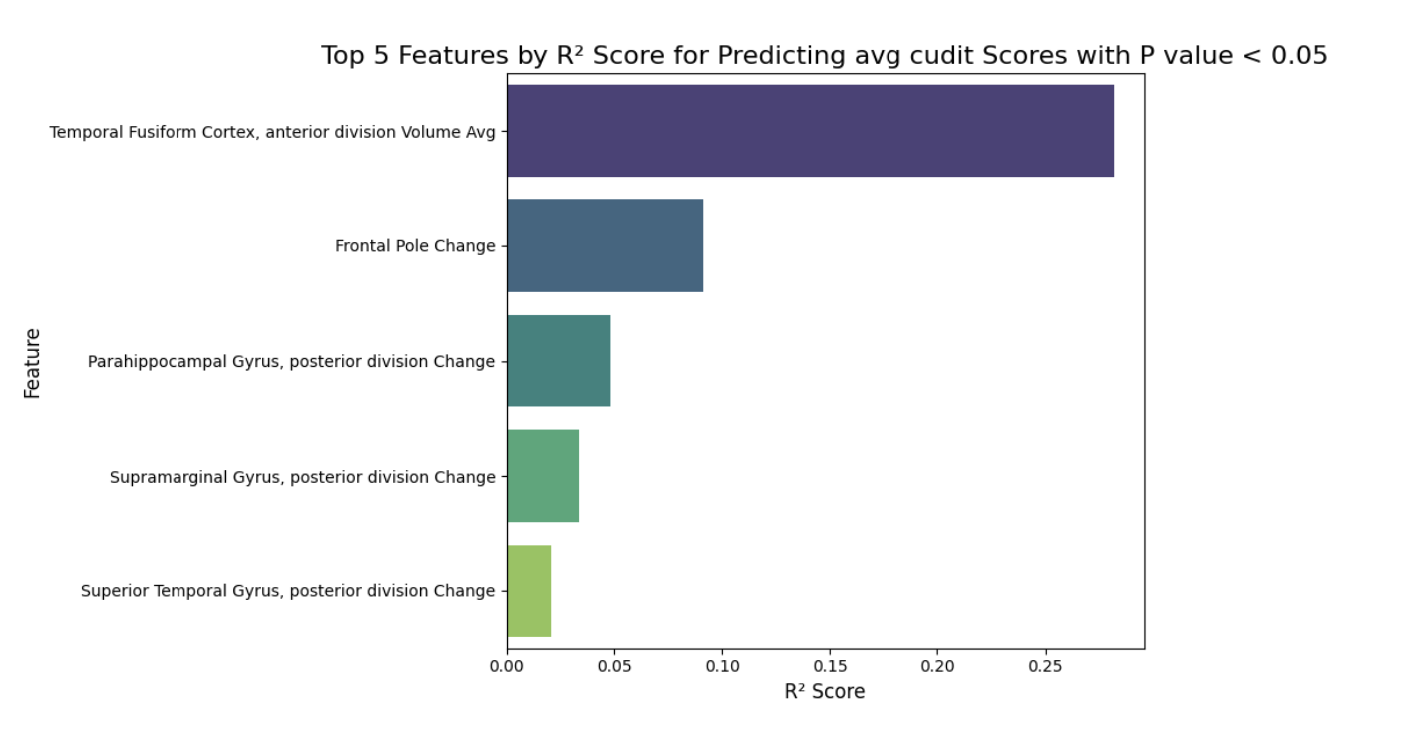
Conclusions
“...regular cannabis use is “associated with gray matter volume reduction in the medial temporal cortex, temporal pole, parahippocampal gyrus...” (Battistella et al., 2014).
“In this study, we found that chronic exposure to marijuana reduces OFC (Orbital Frontal Cortex) gray matter volume...” (Gilman et al., 2014)

Slide 14
Project Structure
Data Sourcing
MRI Preprocessing
Matching MRI to template
Region & Volume Analysis
Statistical Analysis

